Slide 1
CHARACTERIATION TECHNIQUES ON NANOPARTICLES
Done by:-
Kota. Lohith – 2022MMB1384
B. Deepak Teja – 2022MMB1404
Pranav Somani – 2022MMB1388
Kamran Mehdi – 2022MMB1381
Tilak Sanghvi – 2022MMB1391
Divesh – 2022MMB1376
Narandra Nayak – 2022MMb1406
Prerna – 2022MMB1407
Yuvraj – 2022MMB1393

Slide 2
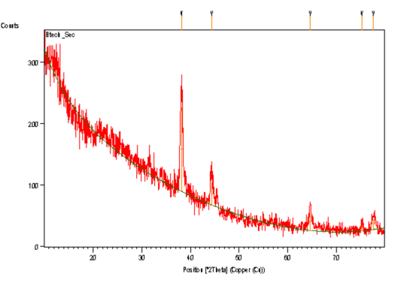
XRD:-
Peak List:-
Pos.[°2Th.] Height [cts] FWHMLeft[°2Th.] d-spacing [Å] Rel. Int. [%]
38.190(9) 138(7) 0.43(4) 2.35467 100.00
44.39(2) 37(3) 0.69(7) 2.03898 27.07
64.61(2) 29(3) 0.7(1) 1.44126 21.43
75.23(5) 10(3) 0.4(2) 1.26201 6.98
77.60(3) 18(2) 0.8(1) 1.22928 13.26

Slide 3
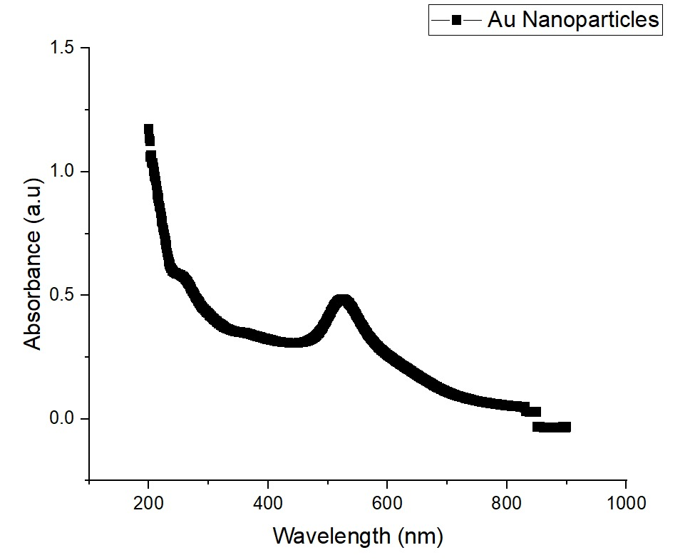
UV-Visible Spectroscopy:-
Sample:- Au Nanoparticles
Reference Sample:- Distilled Water
Peak observed:- Around 500-520nm

Slide 4
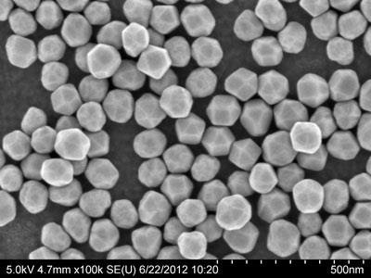
Scanning Electron Microscope(SEM):-
SEM image of gold nanoparticles deposited by spontaneous evaporation of the solvent after drop casting on
a silicon substrate stabilized by polyvinylpyrrolidone
(metallic core diameter of 24.4 nm).

Slide 5
Self-ordered nanoparticle arrays were prepared by a modified Langmuir–Blodgett technique and spontaneous evaporation of the solvent onto a Si substrate after drop casting (Chitu et al., 2010). The formation of homogeneous ordered nanoparticle arrays by self assembly depends on the density of nanoparticles and the fraction of the unbound surfactant in the solution. Local ordering of the self-assembled arrays and the nanoparticle morphology were inspected by SEM. The SEM images revealed homogeneous nanoparticle arrays with hexagonal close-packed ordering of spherical nanoparticles. The ability of self assembly into ordered arrays proves a small nanoparticle size dispersion that is basically determined by the length of the surfactant stabilizing the nanoparticles in the solution. The SEM also showed that the oleylamine stabilized nanoparticles have a smaller size dispersion than those stabilized by polyvinylpyrrolidone.

Slide 6
COMPARING SEM WITH TEM AND AFM
AFM has several advantages over SEM/TEM for characterizing NMs. Images from an AFM represent data in 3D so that it is possible to measure the height of the NPs quantitatively. With an SEM/TEM, the images measured are, in general, only two dimensional.

